Slide 1
Morphine and Cardiovascular Outcomes
Among Patients With Non-ST-Segment
Elevation Acute Coronary Syndromes
Undergoing Coronary Angiography
Published on 28th Jan 2020 JOURNAL OF THE AMERICAN COLLEGE OF CARDIOLOGY

Slide 2
Morphine
Sertuner in 1806 named it ‘morphine’ after the Greek god of dreams Morpheus
Principal alkaloid in opium

Slide 3
Actions on CNS
Strong analgesic – dull, poorly localized visceral pain is relieved better than sharply defined somatic pain
Suppression of pain perception is selective, without affecting other sensations or producing proportionate generalized CNS depression
Perception of pain and the emotional component induced by it are altered

Slide 4
The analgesic action has spinal and supraspinal components
Release of glutamate from primary pain afferents in spinal cord and its postsynaptic action on dorsal horn neurons is inhibited
Action at supraspinal sites in medulla, periaqueductal gray matter, limbic and cortical areas alters processing and interpretation of pain impulses

Slide 5
CVS
Causes vasodilatation due to:
Histamine release
Depression of vasomotor centre
Direct action decreasing tone of blood vessels

Slide 6
GIT
Action directly on intestines and in the CNS increases tone and segmentation but decreases propulsive movements

Slide 7
Plasma t1/2 avg 2-3 hrs
Effect of parenteral dose lasts 4-6 hours
Elimination is complete in 24 hrs and noncumulative
Primarily metabolized in liver by glucuronide conjugation

Slide 8
Morphine recommended for management of acute chest pain in patients with ACS since the beginning of the 20th century
Currently, morphine is endorsed by all guidelines for the management of pain in patients with NSTEACS although no randomized trial has been conducted so far to assess its clinical safety

Slide 9
Background
Mechanistic studies have shown that morphine blunts the antiplatelet effects of oral adenosine diphosphate receptor blockers
Clinical relevance of this interaction is controversial

Slide 10
Morphine and other opioids - delay absorption and blunt the antiplatelet effect of oral adenosine diphosphate (ADP) receptor blockers.
Hobl et al. - concomitant morphine reduced active metabolite exposure and antiplatelet effects after a loading dose of 600 mg clopidogrel.

Slide 11
Interaction also shown for prasugrel and ticagrelor in stable patients post-ACS, in acute myocardial infarction (MI), and during elective percutaneous coronary intervention
These data led the U.S. FDA in 2018 to update the labels of all 3 widely used oral ADP blockers (clopidogrel, prasugrel, and ticagrelor) to include a warning about drug interaction with morphine and other opioids

Slide 12
Objectives
To explore the association between morphine and ischemic events in patients (5,438) treated with concomitant clopidogrel presenting with NSTEACS in the EARLY ACS (Early Glycoprotein IIb/IIIa Inhibition in Patients With Non–ST-Segment Elevation Acute Coronary Syndrome) trial.
Patients not treated with clopidogrel (n = 3,462) were used as negative controls.

Slide 13
Methods
POPULATION AND ENDPOINT SELECTION
Post hoc subanalysis from the EARLY ACS trial
Randomly assigned high-risk patients with NSTEACS to early (i.e., before coronary angiography) versus delayed, provisional (during or soon after percutaneous coronary intervention) use of the intravenous glycoprotein IIb/IIIa antagonist eptifibatide.

Slide 14
Eligible patients had NSTEACS presenting in the first 24 h after symptom onset with at least 2 of the following high-risk features:
ST-segment deviation, increased troponin, or age of >= 60 years
The time from hospital presentation to enrollment was no more than 12 h
All patients planned to undergo an invasive management, and randomization took place before cardiac angiography.
Invasive procedures to be performed at least 12 h after the study drug was started.

Slide 15
Randomization was stratified according to intention to use upstream clopidogrel before coronary angiography.
Information regarding clopidogrel use within 24 h before randomization was prospectively reported by the investigators.
Intravenous morphine use was also reported by the investigators in a dedicated field on the study case report form as occurring within 7 days before randomization or not.

Slide 16
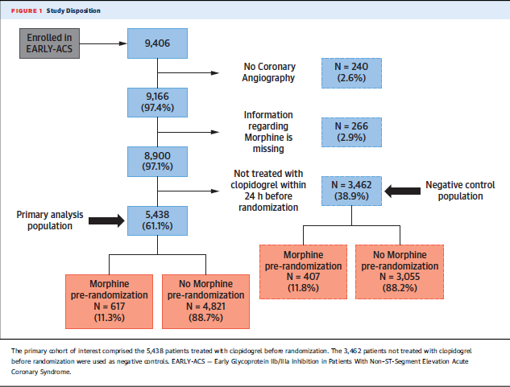

Slide 17
Primary endpoint: composite of death, nonfatal MI, recurrent ischemia with need for urgent revascularization, or thrombotic bailout at 96 h
Secondary endpoint: death or MI at 30 days
This study also analyzed bleeding per Thrombolysis In Myocardial Infarction (TIMI) criteria at 120 h.
Analyzed death or MI at 96 h and bleeding per TIMI criteria at 96 h as exploratory endpoints

Slide 18
Recurrent ischemia requiring urgent revascularization (RI-UR)
During hospitalization: a new episode of ischemic signs or symptoms at rest with documentation of a new ST-segment shift >0.05 mV (0.5 mm) on a 12-lead ECG that necessitates an unplanned PCI or CABG.
After hospitalization: readmission within 30 days of randomization for an episode of ischemic signs or symptoms at rest that required cardiac catheterization and revascularization before discharge.

Slide 19
Thrombotic bailout
(TBO)
Refractory ischemia that occurred during the course of PCI and was defined as the administration of a glycoprotein IIb/IIIa inhibitor after the initiation of PCI (defined as the time when the wire passed the lesion) for the management of any one of the following 7 complications:
Decrement in Thrombolysis in Myocardial Infarction (TIMI) flow grade,
Dissection with decreased flow,
Distal embolization,
Side branch closure,
Abrupt closure of the culprit vessel,
Clinical instability believed to be due to coronary ischemia and/or thrombotic complications,
Prolonged ischemia (e.g., ischemic symptoms or ST-segment changes that develop during the procedure).

Slide 20
TIMI Bleeding Classification
Major:
1) Any intracranial bleeding, OR
2) Clinically overt signs of hemorrhage associated with a drop in hemoglobin (Hb) of ≥5 g/dL (or, when hemoglobin is not available, a fall in hematocrit of ≥15%), OR
3) Fatal bleeding (a bleeding event that directly led to
death within 7 days)

Slide 21
Minor:
Any clinically overt sign of hemorrhage (including imaging) that was associated with a fall in Hb of 3 to 5 g/dL (or, when hemoglobin was not available, a fall in hematocrit of 9 to 15%)

Slide 22
Statistical Analysis
Results are summarized as odds ratios (ORs) with corresponding 95% confidence intervals (CIs).
Developed a propensity score model for morphine use.
The score was built from a logistic regression model, taking into account all variables with significant (p < 0.05) differences or >10% standardized differences between the groups of interest (morphine vs. no morphine).

Slide 23
Missing data at baseline were infrequent (<3% for most variables).
However, for creatinine and ejection fraction at baseline, data were missing in >3% of patients (3.5% for the former and 21.5% for the latter).
Because these were of clinical interest in conjunction with morphine use, a multiple imputation approach was taken to fill all missing baseline characteristics before generating propensity score models.

Slide 24
Standardized differences before and after inverse probability of treatment weighting (IPTW) adjustment were examined graphically.
A standardized difference of <10% was considered to be an acceptable balance of measured baseline characteristics by morphine use

Slide 25
For the landmark analysis, study used a multivariable Cox proportional hazards model to derive hazard ratios and CI.
All tests were 2-sided, and a p value <0.05 was considered statistically significant

Slide 26
Descriptive Statistics

Slide 27
Of these 5,438 patients, 3,927 (72.2%) were treated with <600 mg clopidogrel loading dose, 862 (15.9%) were treated with 600 mg or more, and the remaining 649 (11.9%) had no available information about the clopidogrel loading dose.
Among them, 617 (11.3%) patients were administered morphine before randomization, and 4,821 (88.7%) were not

Slide 28
There were 3,462 patients who were not pretreated with clopidogrel in the 24 h before randomization (negative control), among whom 407 (11.8%) were administered morphine before randomization, and 3,055 (88.2%) were not.

Slide 29
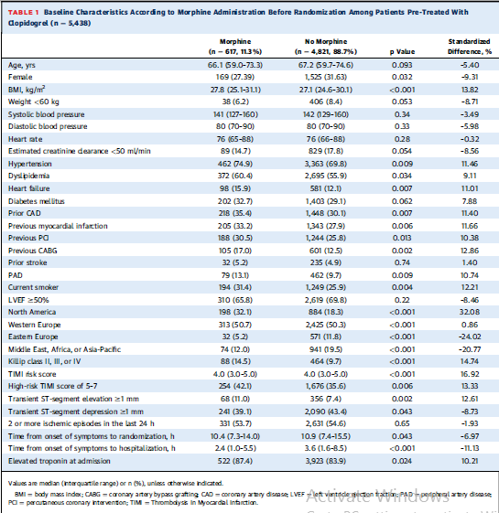

Slide 30
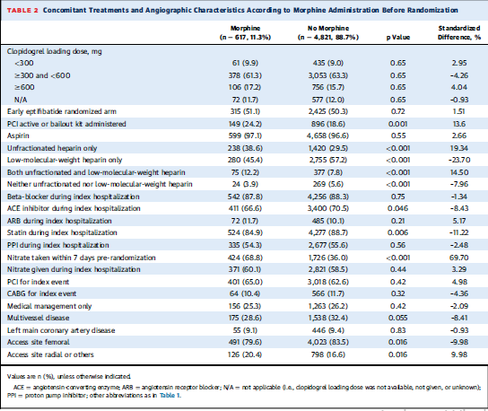

Slide 31
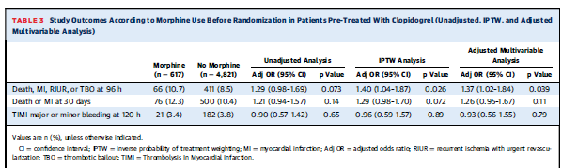
Outcomes according to Morphine use

Slide 32
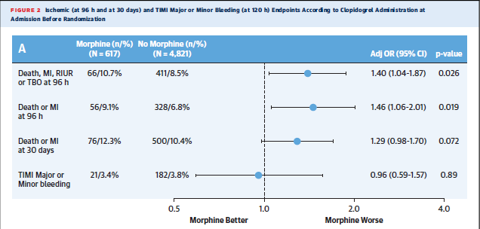

Slide 33
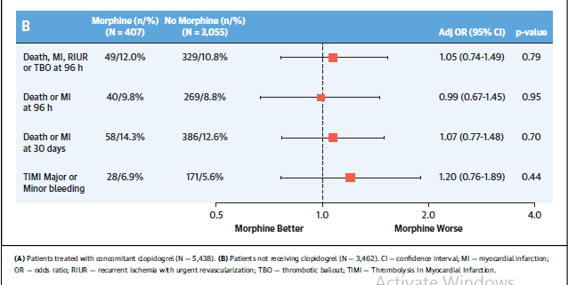

Slide 34
LANDMARK AND NONCARDIOVASCULAR EVENTS
ANALYSES
When only events occurring in the first 48 h were considered, there was an even stronger association of morphine use with higher rates of death or MI in patients pre-treated with clopidogrel (adjusted hazard ratio: 1.54; 95% CI: 1.07 to 2.23; p = 0.021).
Conversely, after excluding events in the first 48 h, there was no longer a difference in rates of death or MI between both morphine groups among patients taking concomitant clopidogrel (adjusted hazard ratio: 1.00; 95% CI: 0.67 to 1.49; p = 0.99).
Among patients not taking concomitant clopidogrel, there was no association with higher event rates either at 48 h or after this time point.

Slide 35
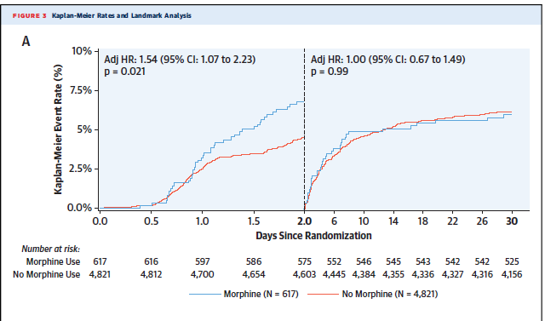

Slide 36
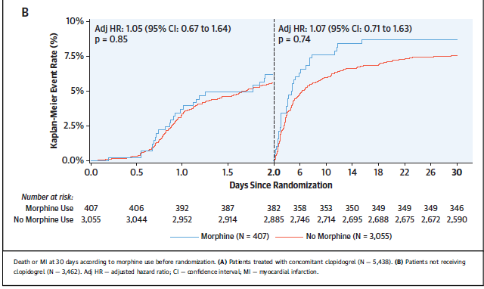

Slide 37
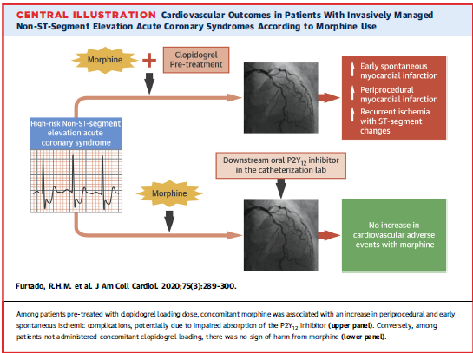
Discussion

Slide 38
Morphine used concomitantly with clopidogrel pretreatment associated with higher short-term risk of acute ischemic events among patients with invasively managed NSTEACS
Based on these results, higher risk of ischemic events with morphine restricted to patients treated with concomitant clopidogrel is most likely explained by a clinical interaction between these drugs

Slide 39
COMPARISON WITH OTHER PRIOR STUDIES
CRUSADE registry –showed morphine use in the first 24 h of hospitalization was associated with higher in-hospital mortality and MI in patients presenting with NSTEACS.
Inverse causality bias may have been present, because morphine use was considered within the first 24 h of admission, and events of interest were in-hospital complications (before or after the first 24 h).
This study took into account only morphine use before randomization so that the endpoints of interest were ascertained after that time point

Slide 40
In the FAST-MI registry, no association between pre-hospital morphine and death or MI in a cohort of patients with STEMI was observed
Morphine-treated patients received better pre-hospital care, with greater use of reperfusion therapy, shorter door-to-balloon times, and more use of evidence-based medications than patients not treated with pre-hospital morphine

Slide 41
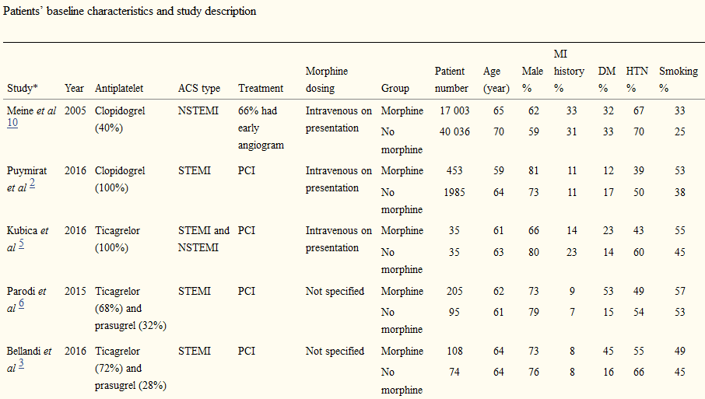
Meta analysis

Slide 42
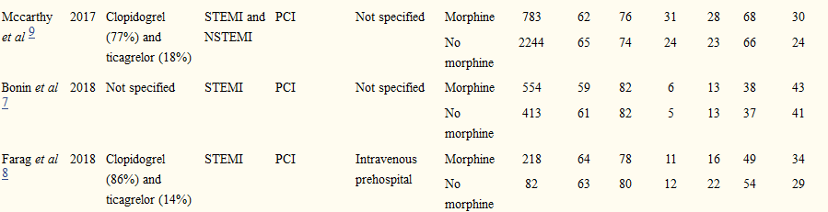

Slide 43
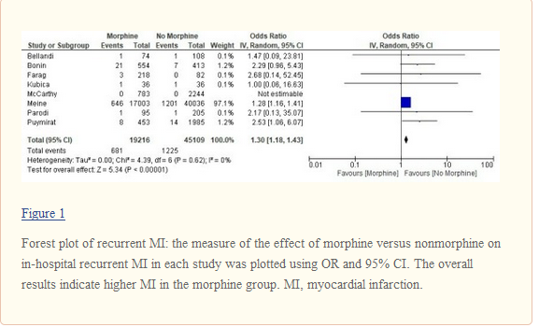

Slide 44
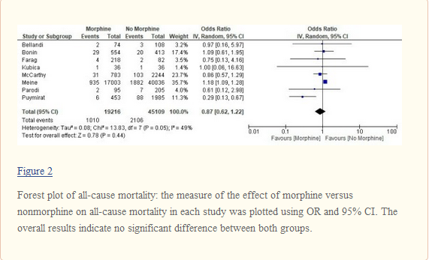

Slide 45
IMPLICATIONS FOR FUTURE GUIDELINES
Society guidelines continue to endorse morphine or other intravenous opioids for pain management in NSTEACS, although some have downgraded the recommendation after the first reports of possible harmful morphine effects
In 2018, the FDA updated all currently used oral ADP receptor blocker labels regarding this issue, and the European Medicines Agency made similar recommendations

Slide 46
IMPLICATIONS FOR FUTURE RESEARCH
Given the paucity of effective non-narcotic options for pain management in NSTEACS, these results are intended to encourage new investigation on alternative treatments.
Replacing morphine with other opioids may be a reasonable approach

Slide 47
PACIFY (Platelet Aggregation With Ticagrelor Inhibition and Fentanyl) trial showed that fentanyl blunted ticagrelor effect and led to more myocardial damage (assessed by high-sensitivity troponin) during elective PCI, thus raising concerns that this interaction could be a class effect from all opioids

Slide 48
Strengths
This study found no such association in the cohort of patients not pre-treated with concomitant clopidogrel, which makes the hypothesis being tested, that is, that the pharmacokinetic interaction between morphine and clopidogrel may have clinical impact, more plausible.
Moreover, both the absence of any association between morphine and ischemic events occurring after the first 48 h (landmark analysis) and the absence of any association between morphine use and noncardiovascular events (falsification endpoints) also support the hypothesis being tested

Slide 49
Limitations
1. As with any observational report, study cannot establish a definitive causal relationship because the results may be related to unmeasured confounders.
If higher risk with morphine was due only to confounding by indication (i.e., sicker patients were more likely to receive morphine), study would expect to see an increase in other noncardiovascular adverse events unrelated to the proposed hypothesis of drug interaction.

Slide 50
2. Another limitation is that the exact time of morphine administration was not recorded.
Because the inclusion criteria from the EARLY ACS trial required eligible individuals to be enrolled within the first 12 h of hospital presentation and within 24 h of symptoms onset, it is likely that clopidogrel and morphine before randomization were taken within a few hours of each other.
The administration of morphine after clopidogrel would have biased toward the null, and these findings may indeed be an underestimate of the true association.

Slide 51
3. Did not record the use of other opioids, such as fentanyl, but this would also bias the results toward the null.
4. Cannot extrapolate these findings to other oral ADP receptor blockers

Slide 52
It might be possible that, due to their faster onset of action and higher levels of platelet inhibition, these findings may not apply to prasugrel and ticagrelor
Data from mechanistic studies have shown the same interaction with prasugrel and ticagrelor
Therefore, those interactions seem to be a class effect for oral ADP blockers and are not only drug specific
5. Low number of deaths precludes any conclusion regarding the relationship of the interactions described here with all-cause mortality.

Slide 53
Conclusions
Among patients presenting with a high-risk, invasively managed NSTEACS, concomitant morphine use with clopidogrel pre-treatment was associated with higher adjusted risk of short-term cardiac ischemic events compared with clopidogrel without morphine.
This finding suggests drug interaction between opioids and oral ADP receptor blockers may impact clinical outcomes.

Slide 54
Is it a chance factor or an association?
48 years old previously healthy male had accidental inhalational exposure to chemicals containing OP.
He immediately developed coughing, drooling of saliva, vomiting, incontinence of urine followed by chest pain.
Initial EKG in the field showed inferior STEMI.
While getting a decontamination shower, he became obtunded and required emergent critco-thyroidotomy due to extensive airway edema.
He was bradycardic which responded to atropine

Slide 55
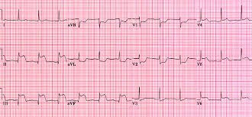

Slide 56
He was transferred to the cath lab urgently as he continued to have chest pain and ST elevation.
He was given OP antidote Pralidoxime with atropine after discussion with toxicology team.
Heart catheterization showed 100% occluded Right coronary artery.
He underwent aspiration thrombectomy and drug-eluting stent placement.

Slide 57
He required vasopressor support for cardiogenic shock.
Airway was changed to tracheostomy and eventually decannulated.
He improved well and discharged home with dual antiplatelet therapy

Slide 58
Patients exposed to OP present with cholinergic symptoms which can masquerade the typical findings of coronary ischemia.
Cardiac manifestations include arrhythmias, myocardial ischemia/ infarction, and cardiac arrest.

Slide 59
Postulated mechanisms include sympathetic over-activity at first, followed by extreme parasympathetic activity, acid-base imbalances, direct toxic effects and release of vasoactive agents, causing thrombo-embolic events.
Though it can be argued this STEMI could be a de novo event, it is plausible that the OP exposure triggered STEMI by above mentioned mechanisms.

